Slide 2
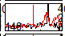
EC24, beep, ch 148, short vs long

Slide 4
Background

Slide 5
Experimental Setup

Slide 6
Anatomy

Slide 7
ECS

Slide 8
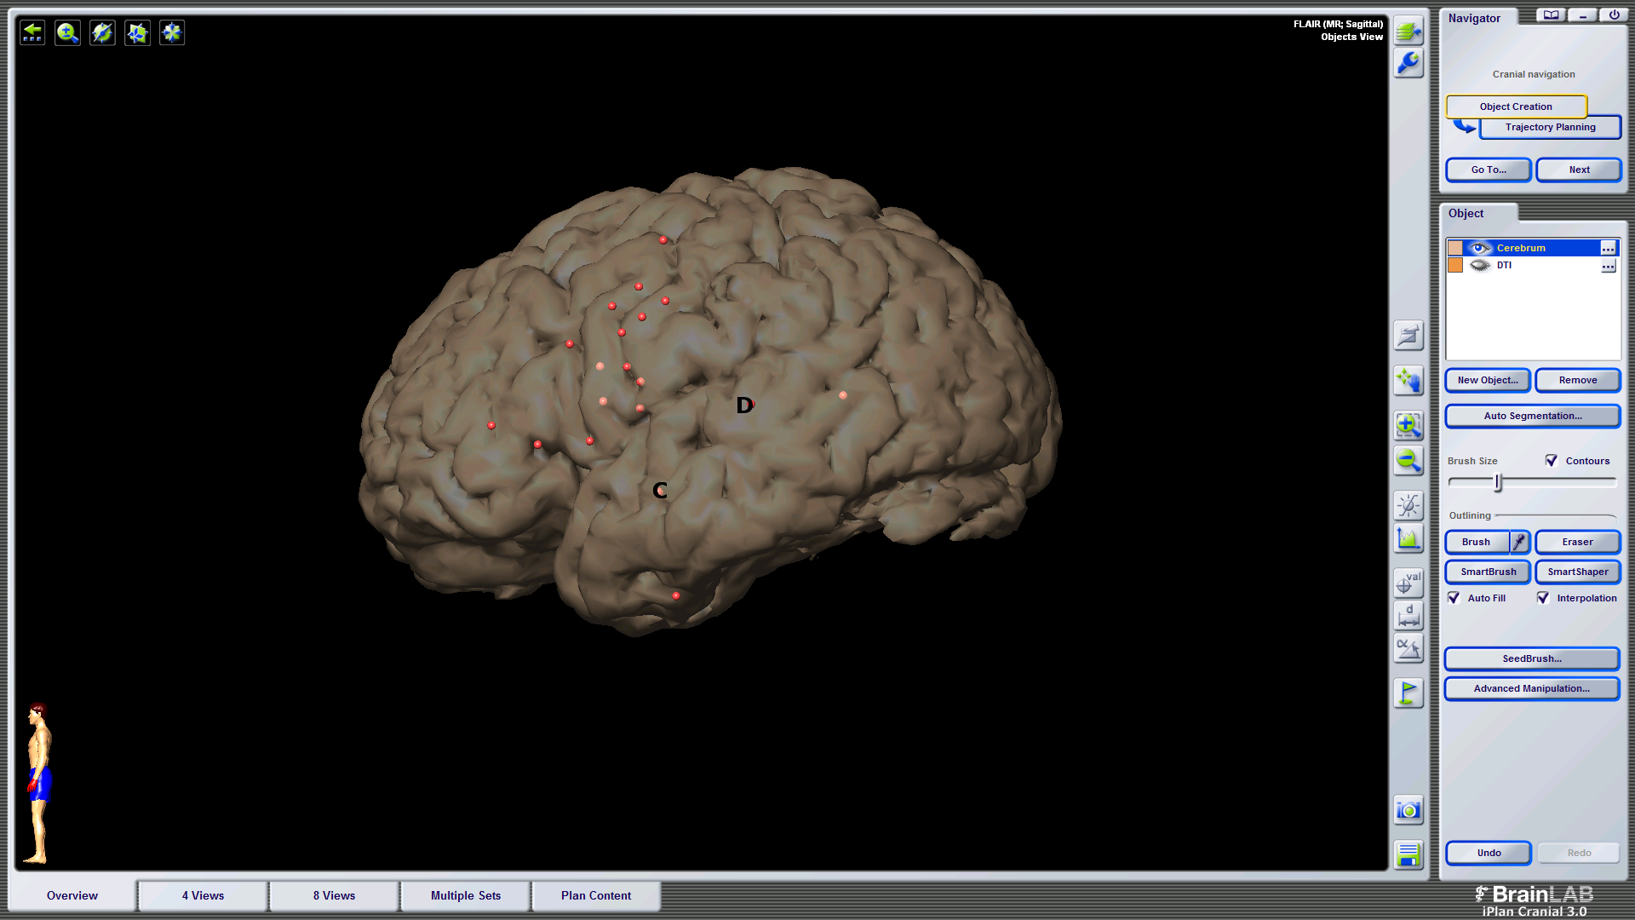
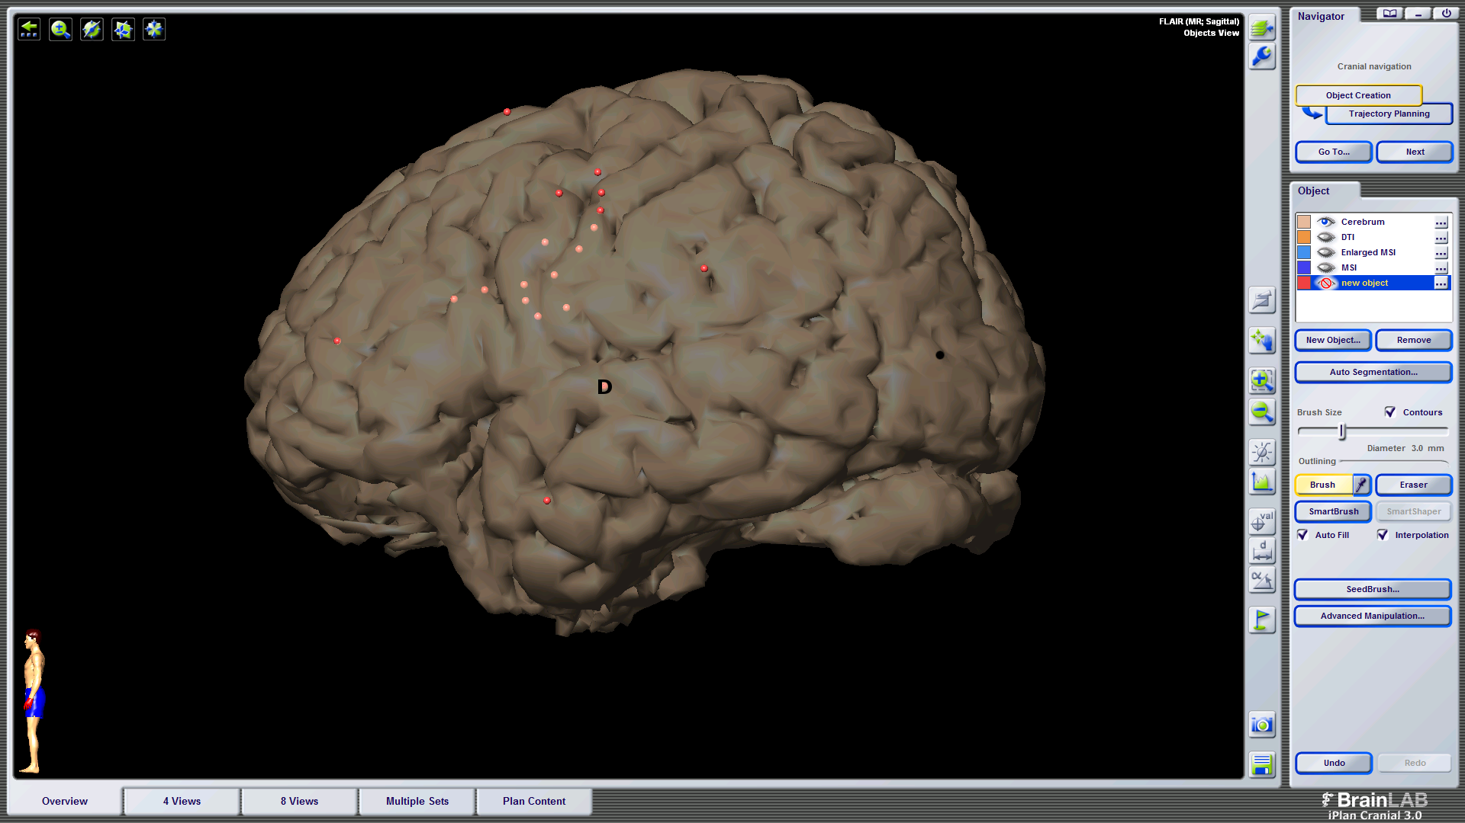
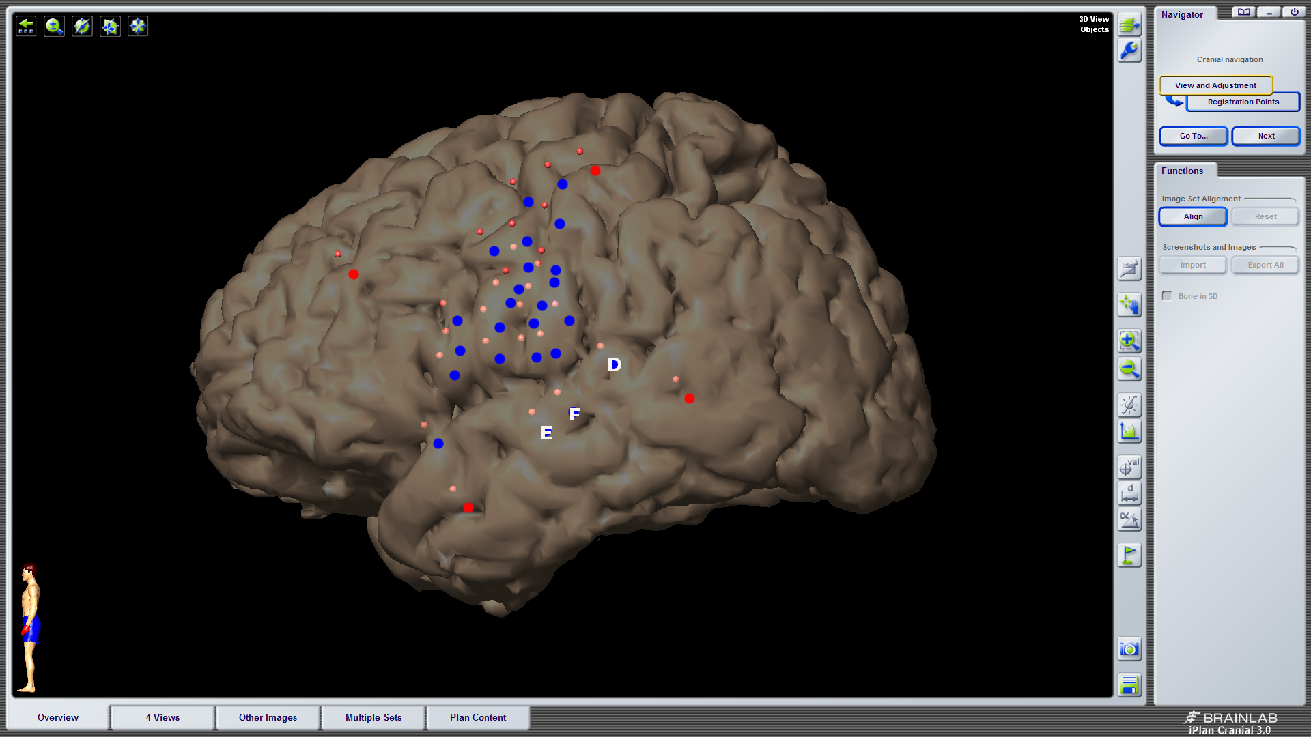
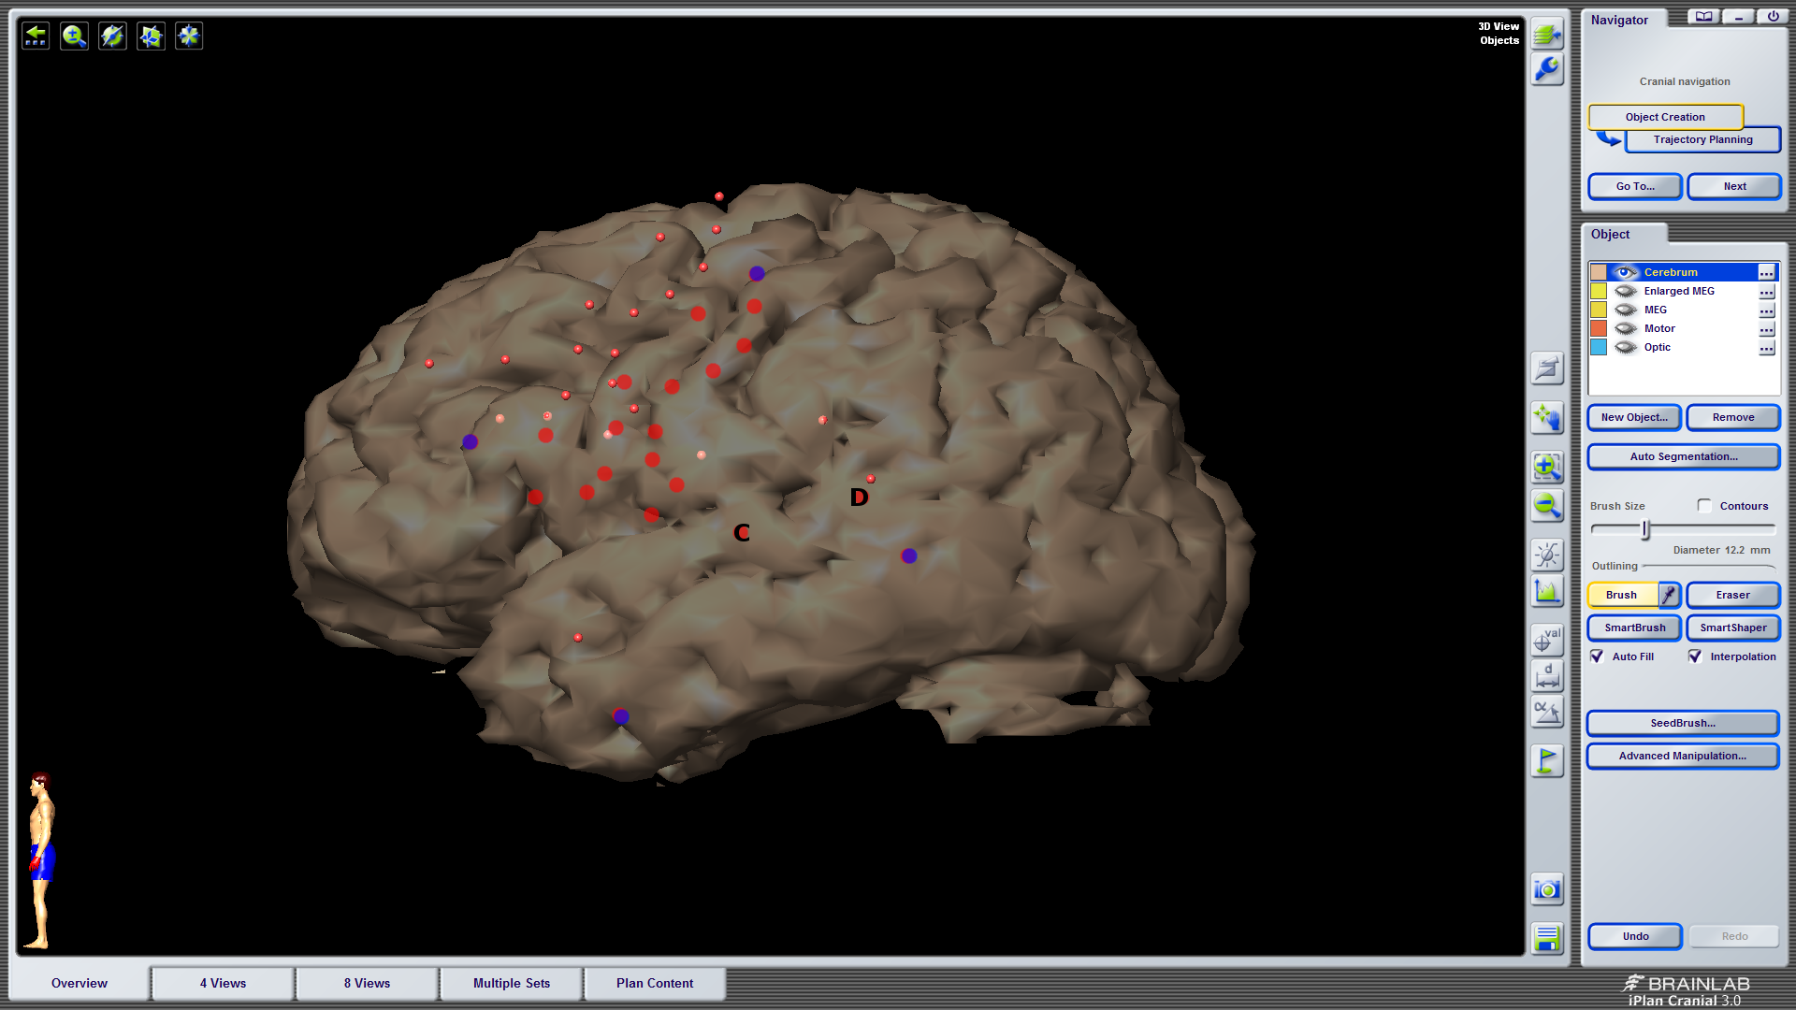
Word: 4/9 (3 perceptual, 1 real word sub)
Delay: 0/0
Rep: 2/9 phonological error
Word: 1/1 perceptual error
Delay: 0/4
Rep: 1/3 Phonological error
Word: 0/0
Delay: 0/2
Rep: 0/2
Word: 1/3 perceptual error
Delay: 0/0
Rep: 0/1 error
Word: 1/1 phonological error
Delay: 0/2 error
Rep: 1/1 phonological error

Slide 9
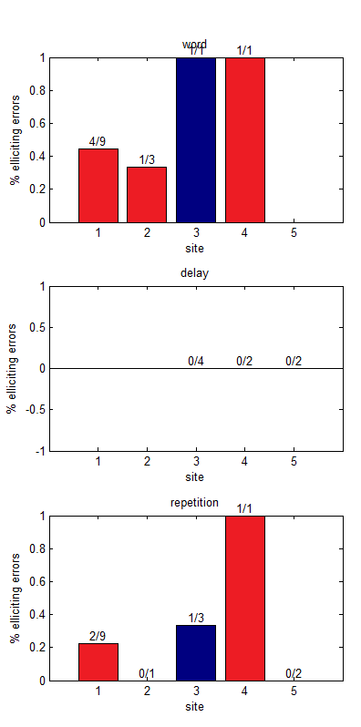
Stimulation error rates
mSTG
pSTG

Slide 11
EC22
9 trials w/ stimulation during target presentation only
a. 4/9 trials caused errors
a. 3 perceptual errors, "I didn't understand it", 1 real word substitution (native -> negative)
6 trials stimulation during buffer window only
a. no errors during buffer period
9 trials w/ stimulation during production window only (1 additional trial with partial stim during buffer)
a. 2/9 trials caused errors
a. classified as phonological errors. these were non-word responses that seemed to be affected by poor phonological selection or altered output during disrupted feedback (e.g, velocity -> velositivity; delivery -> deliverty...deliver...something like that)
Word: 4/9 (3 perceptual, 1 real word sub)
Delay: 0/0
Rep: 2/9 phonological error

Slide 12
EC23
Word: 1/1 perceptual error
Delay: 0/4
Rep: 1/3 Phonological error
SITE 'C'
3 trials w/ stimulation during target window only (2 additional trials w/ bleedover into buffer window)
a. 1/3 trials caused error (1 bleedover trial classified as an error)
a. error classified as perceptual (bleedover error classified as perceptual)
0 trials w/ stimulation during buffer window only
1 trial w/ stimulation during production window only (1 w/ partial stimulation during buffer window)
a. 0 errors (1 error during partial stimulation trial - classified as offset error)
SITE 'D'
1 trial w/ stimulation during target window only
a. 1/1 trials caused error - classified as perceptual error, "i don't know"
4 trials w/ stimulation during buffer window only (3 addition trials w/ bleedover)
a. 0/4 trials w/ error (1/3 trials w/ error - classified as offset error)
2 trials w/ stimulation during production window only
a. 1/2 trials w/ error - classified as phonological error
a. of note: the target was motive and the patient said "moutuh" and then self-corrected and said
"motive" at the stimulation offset
Word: 1/3 perceptual error
Delay: 0/0
Rep: 0/1 error

Slide 13
Site C
Site D

Slide 14
EC24
Word: 0/0
Delay: 0/2
Rep: 0/2
SITES 'E' & 'F' collapsed
1 trial w/ stimulation during target window only (1 trial w/ bleedover into buffer)
a. 1/1 trial caused error - classified as phonological, velocity -> muhgrasity (no error on bleedover trial)
2 trials w/ stimulation during buffer window only (1 trial w/ bleedover)
a. 0/2 trials caused error (no error during bleedover trial)
1 trial w/ stimulation during production window only
a. 1/1 trial caused error - classified as phonological, statistical -> suhdastruh
SITE 'D'
0 trials w/ stimulation during target window only
a. no errors
2 trials w/ stimulation during buffer window only
a. no errors
2 trials w/ stimulation during production window only (1 w/ partial stim during buffer window)
a. no errors
OF NOTE: this patient was very tearful throughout the procedure (labiality and pain seemed to be stimulation-related, perhaps given site of tumor location); there was no epilepsy team and during the probe list the patient stated that he felt an "aura", so he most likely was having a seizure and it may question some of his results during both sets of repetition data
Word: 1/1 phonological error
Delay: 0/2 error
Rep: 1/1 phonological error

Slide 15
Clustering

Slide 16
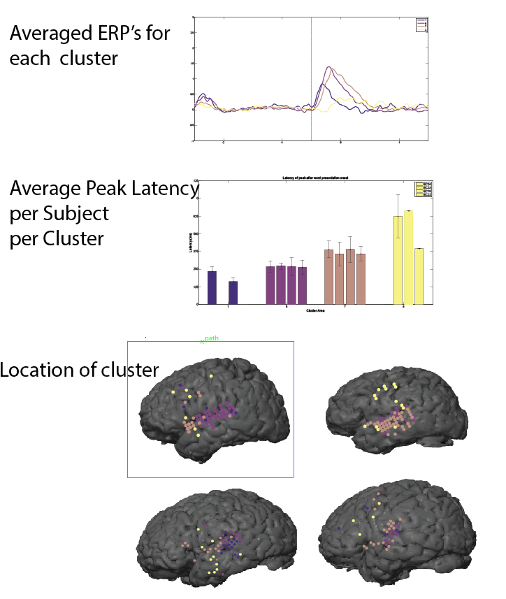
Word Onset

Slide 17
pSTG
pSTG
midSTG
aSTG
STS/motor
aSTG/motor
STS/motor
Broca’s/ motor/aSTG

Slide 18
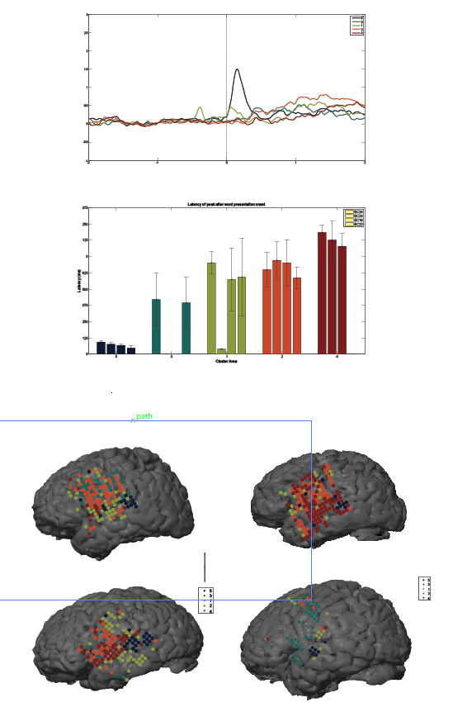
Beep

Slide 20
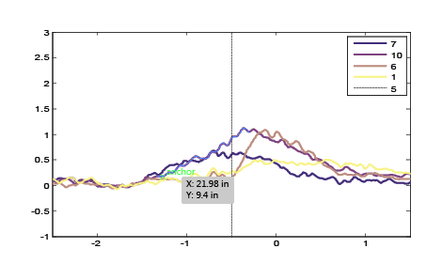
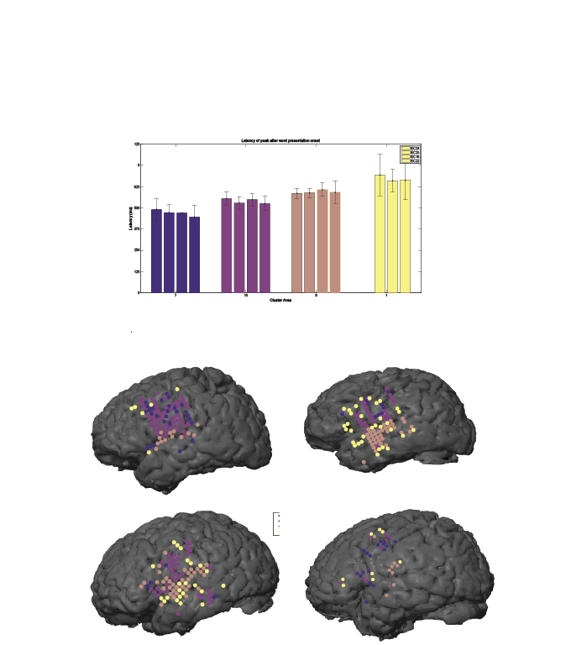
Repetition Onset

Slide 22
Clustering Spectrograms

Slide 23
Round 1
Mean of Cluster
Correlation within cluster
Round 2
Mean of Cluster
Correlation within cluster

Slide 25
Stacked all freq

Slide 26
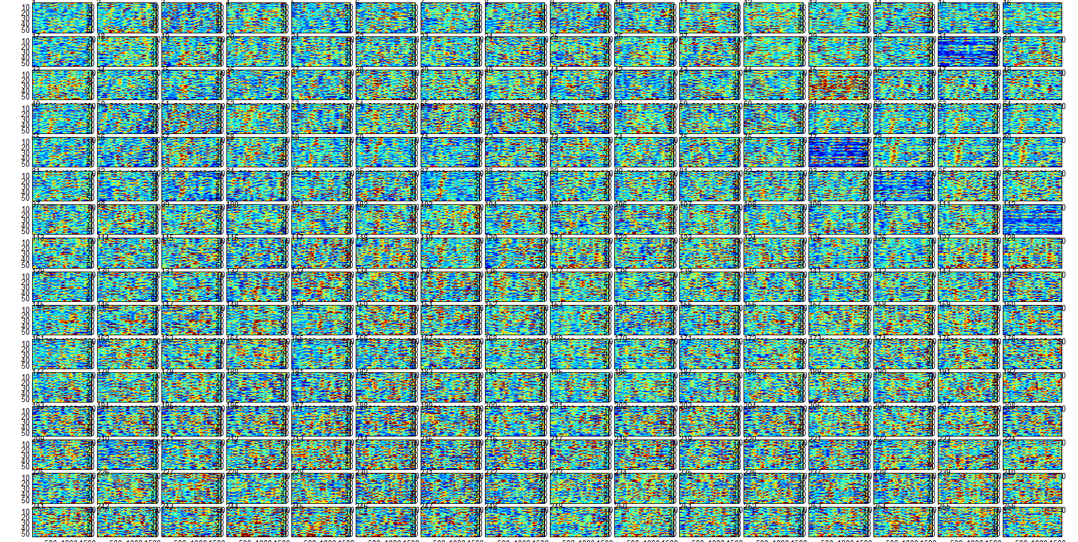
Theta

Slide 27
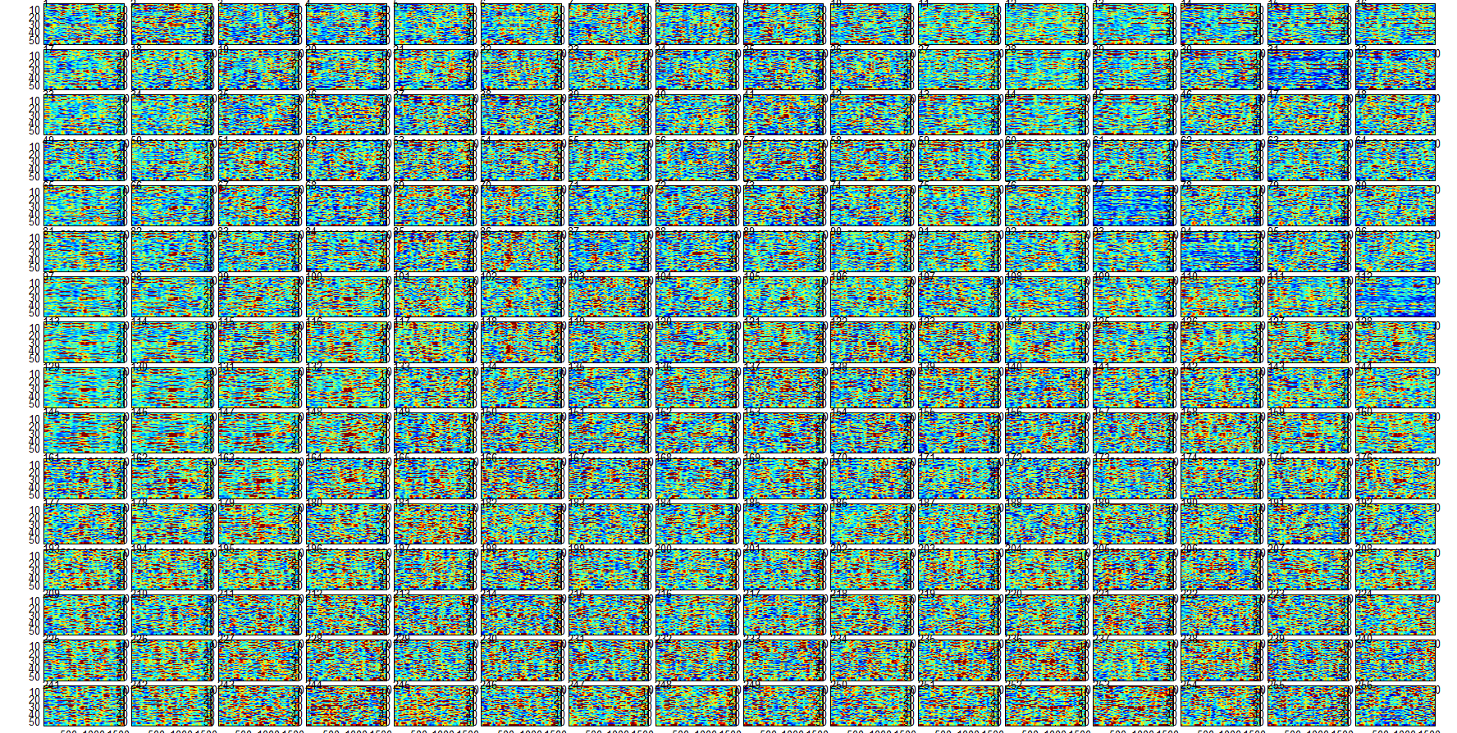
Alpha

Slide 28
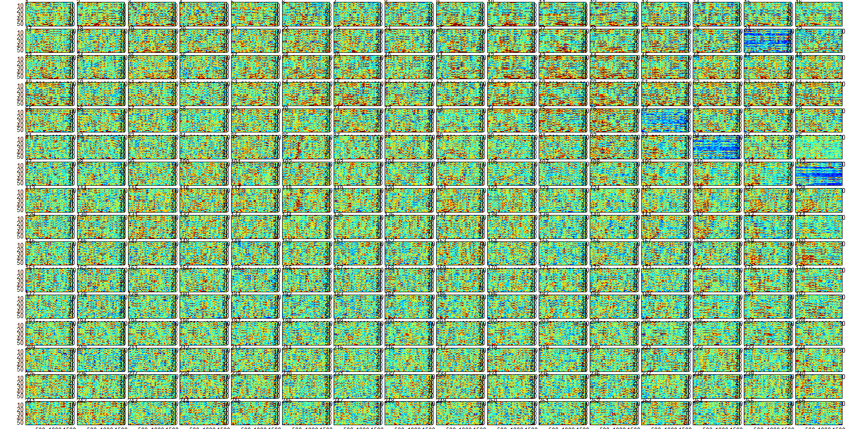
Beta

Slide 29
Gamma

Slide 30
HG

Slide 31
Shortest 16 vs Longest 16 words EC18 WE Aligned

Slide 32
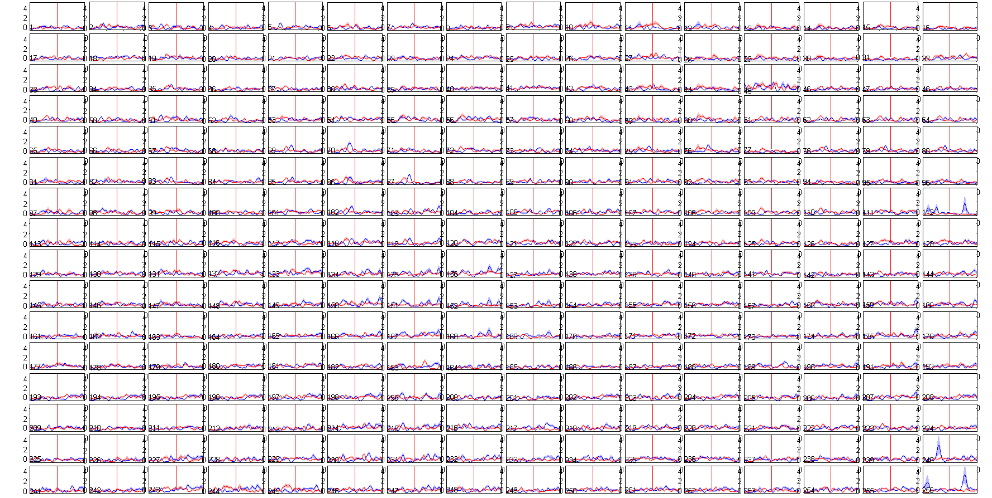

Slide 33
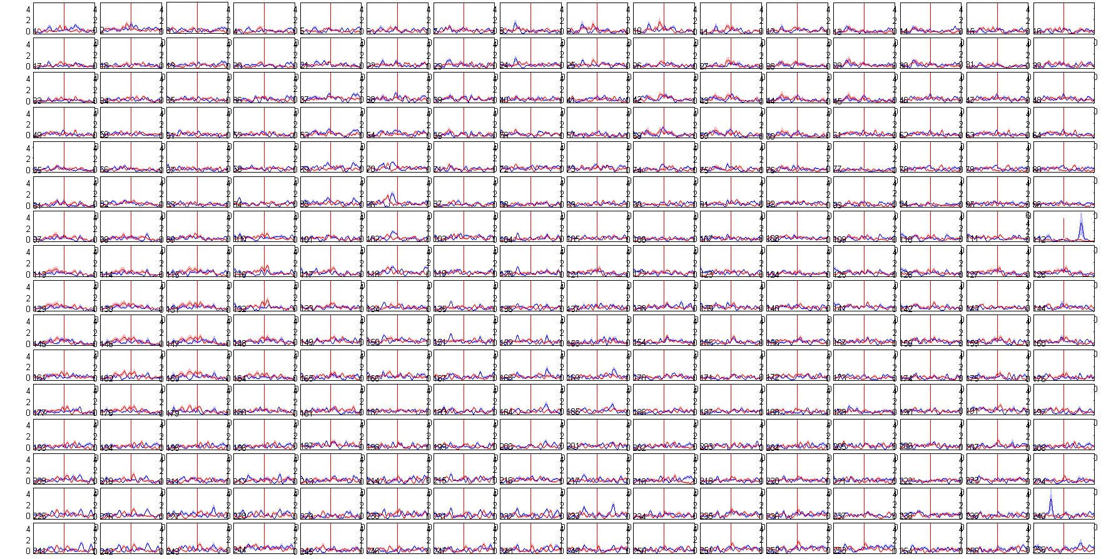

Slide 34
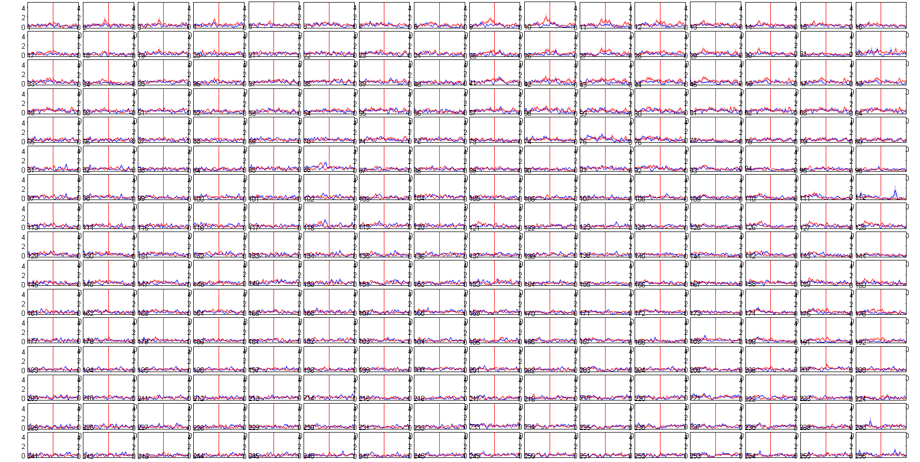

Slide 35
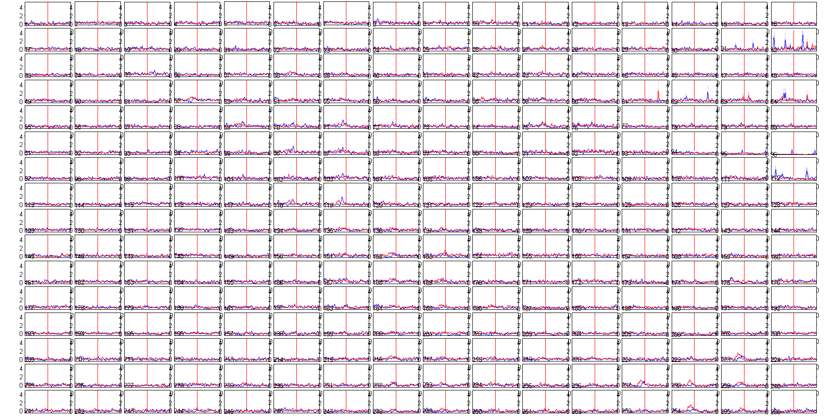

Slide 36
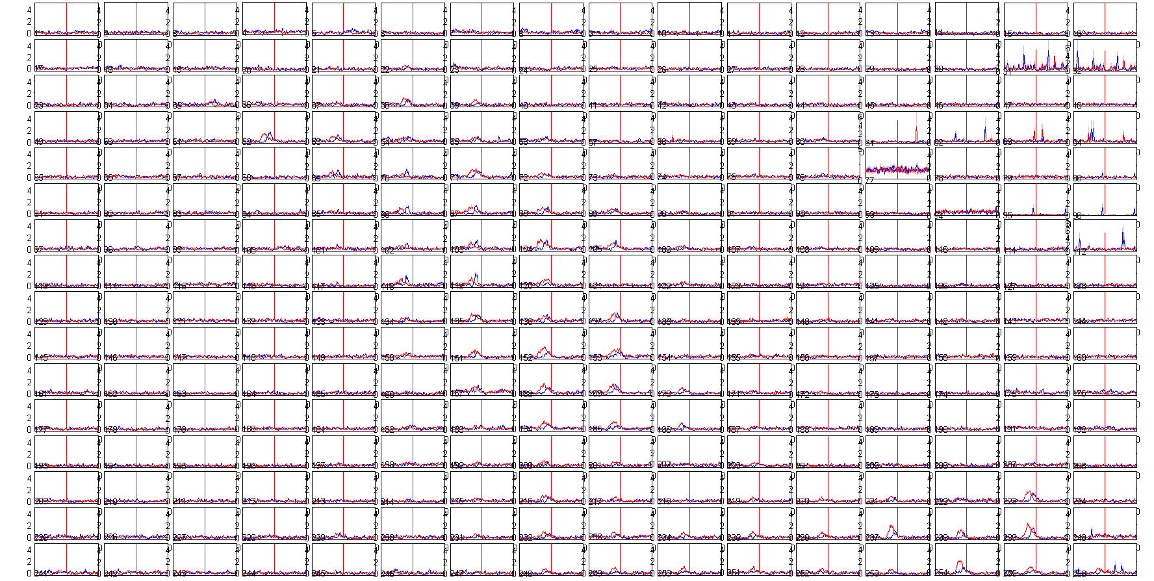

Slide 37
Shortest 16 vs Longest 16 words EC18 RO Aligned

Slide 38
beta

Slide 39
hg

Slide 40
Hg stacked

Slide 41
RO EC18 mean 800:1500

Slide 42
Shortest 16 vs Longest 16 words EC18 ROff Aligned

Slide 45
beta

Slide 46
hg

Slide 47

EC24 Short

Slide 48
EC24 Long

Slide 49
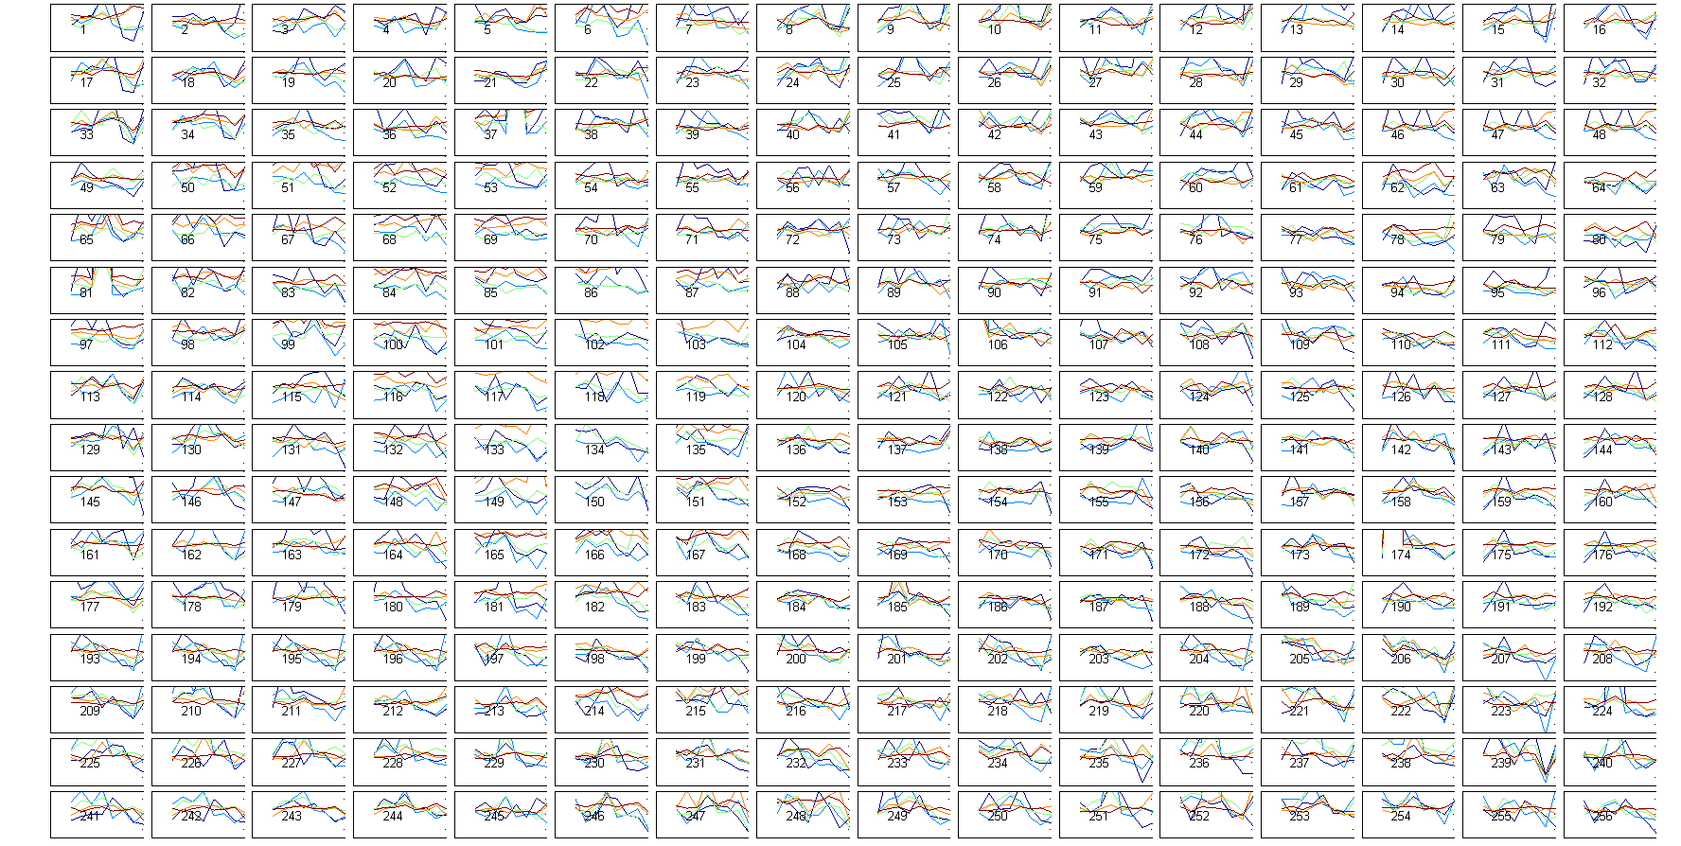

Slide 50
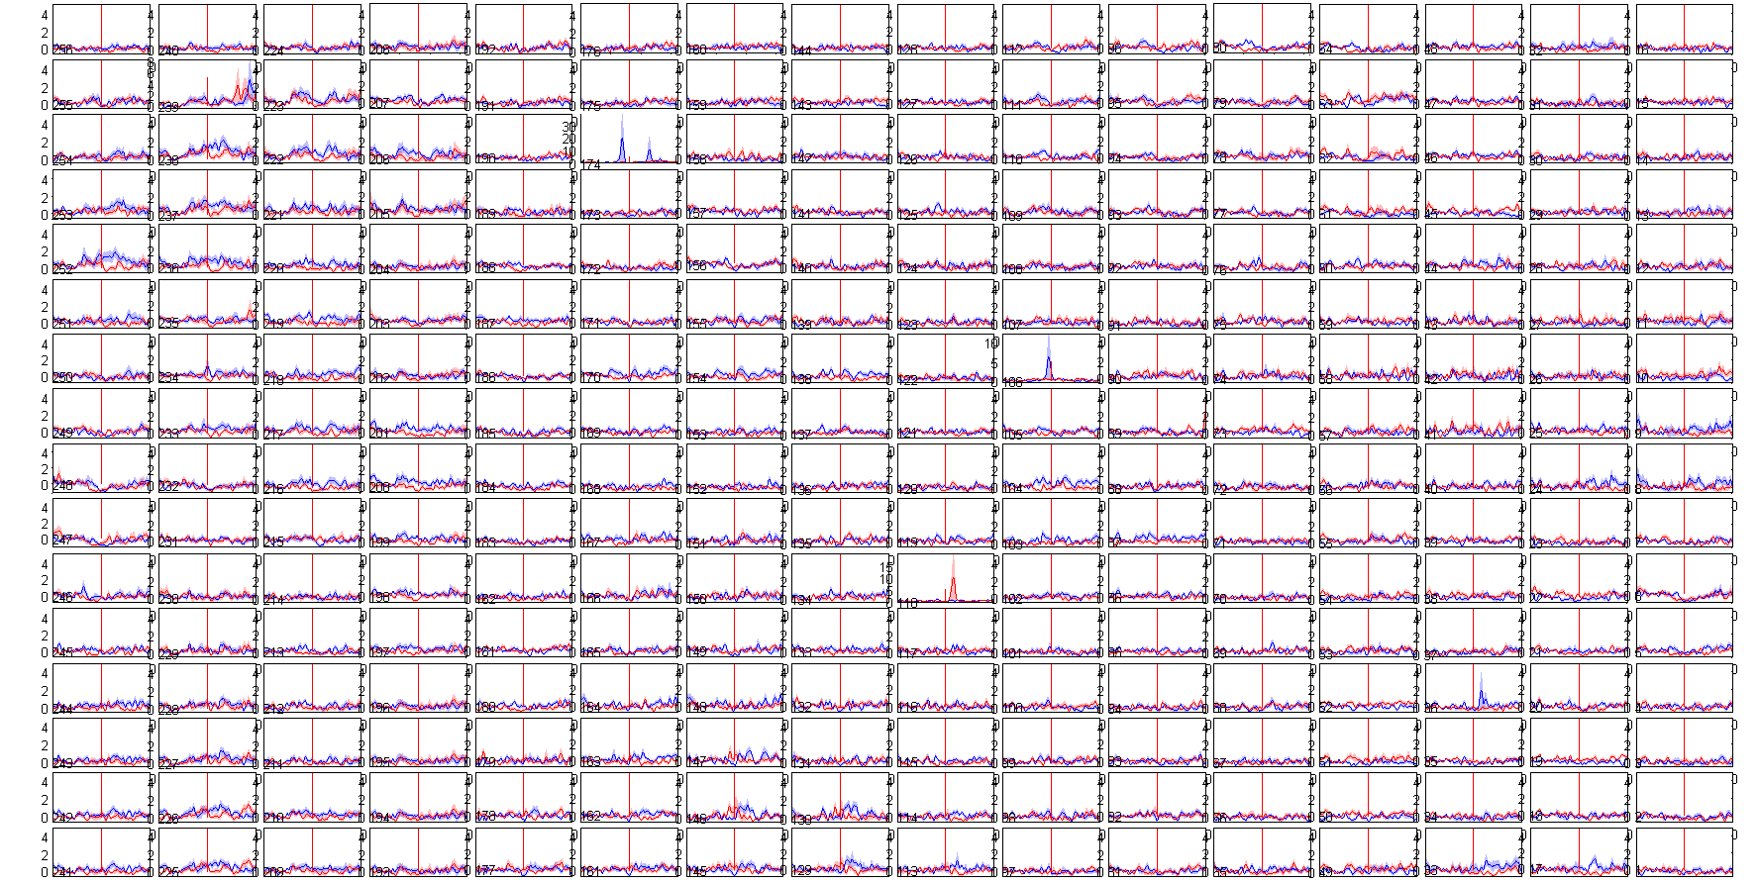

Slide 51
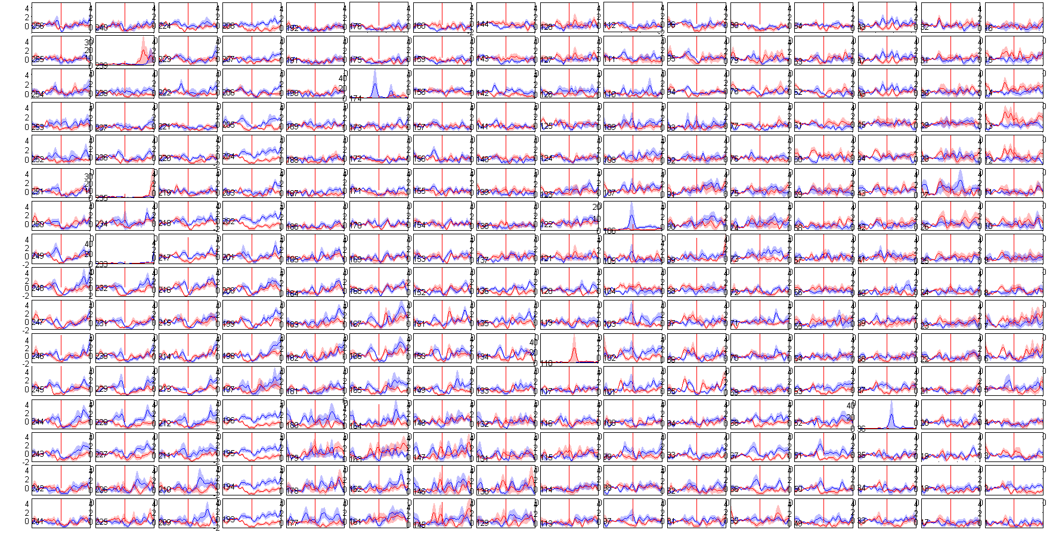

Slide 52
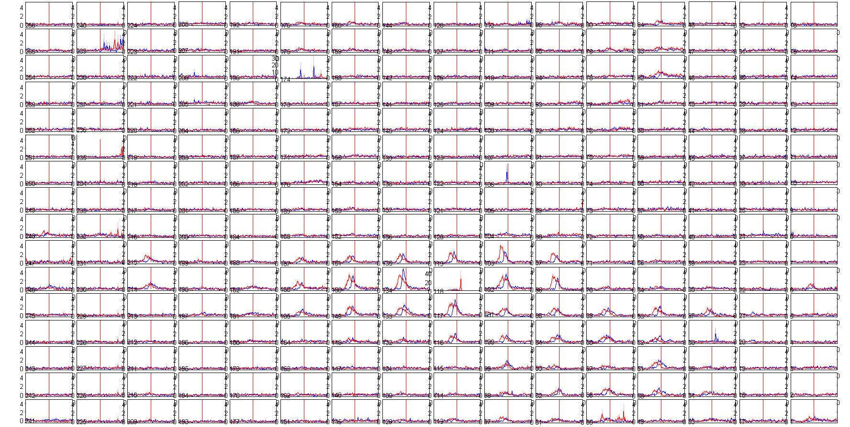

Slide 53
ERPS

Slide 54
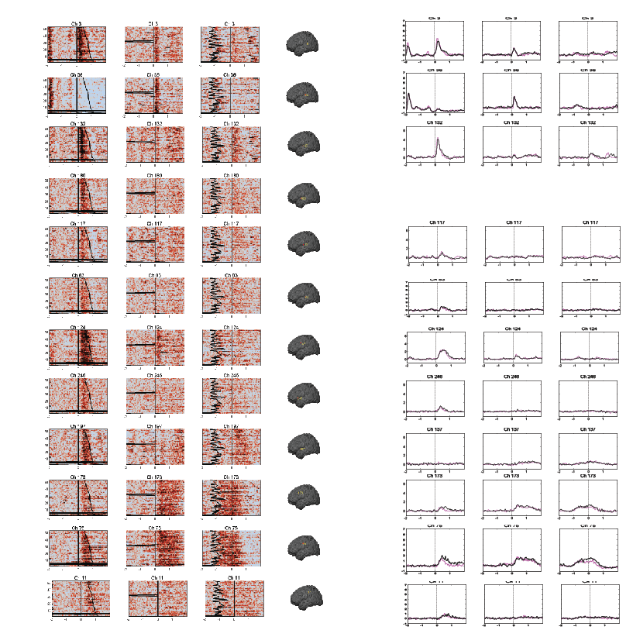
EC24

Slide 55
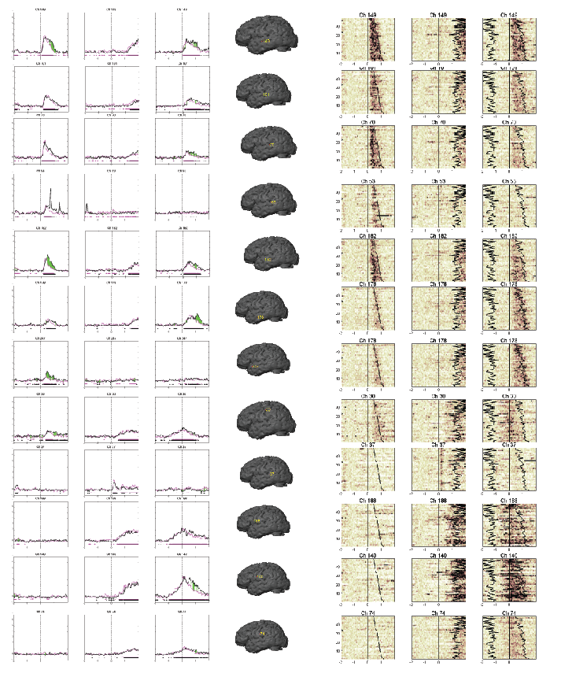
EC23

Slide 56
Word Length Effects

Slide 57
Max Amp vs Word Length Slope (-1 s to Word End)

Slide 58
Max Amp vs Word Length Slope (Word End to 2 sec)

Slide 59
Max Amp vs Word Length Slope (1000-1500 samp)

Slide 62
Max Amp -1 s to WE

Slide 63
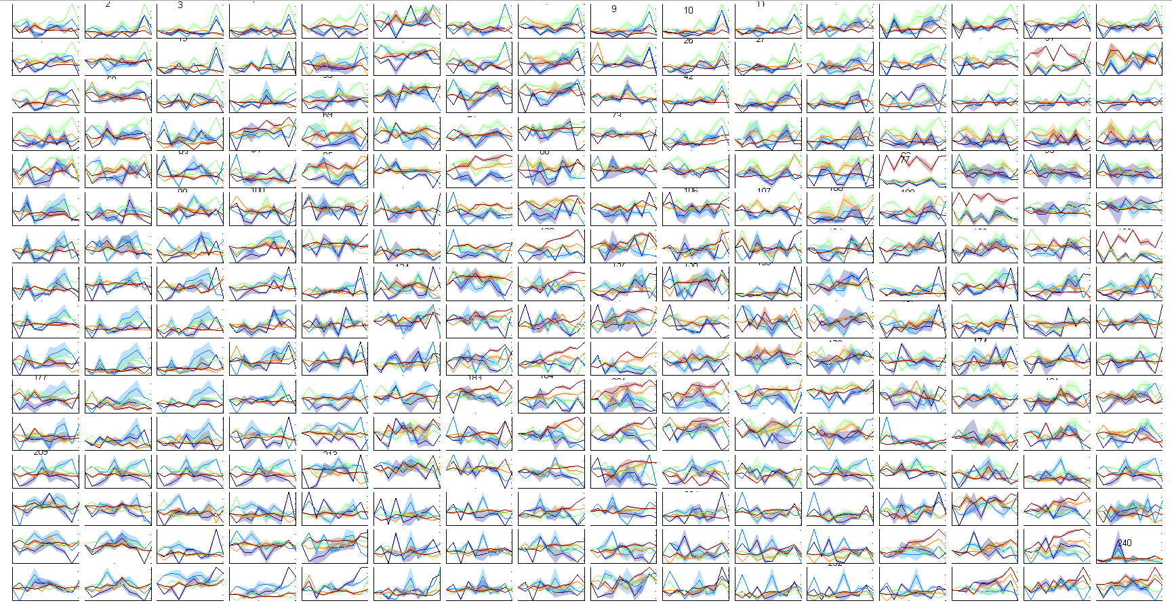
400 to 800 mean

Slide 64
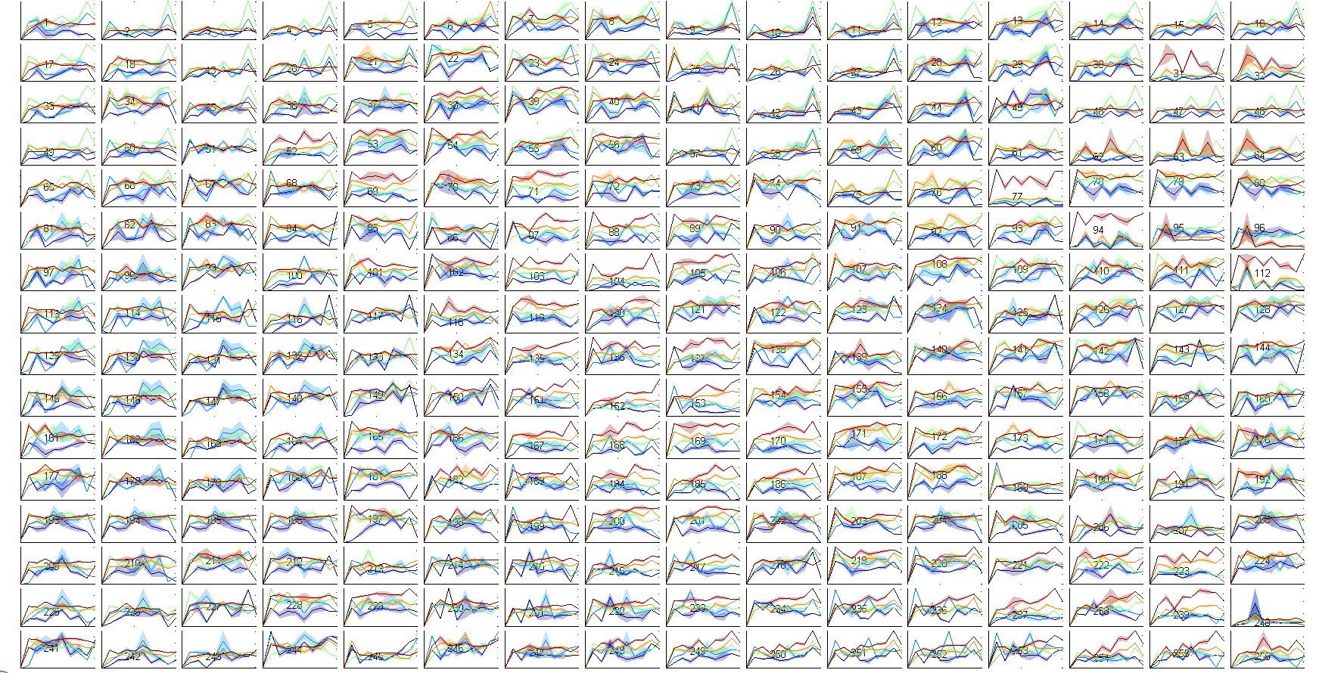
400 to 800 max

Slide 65
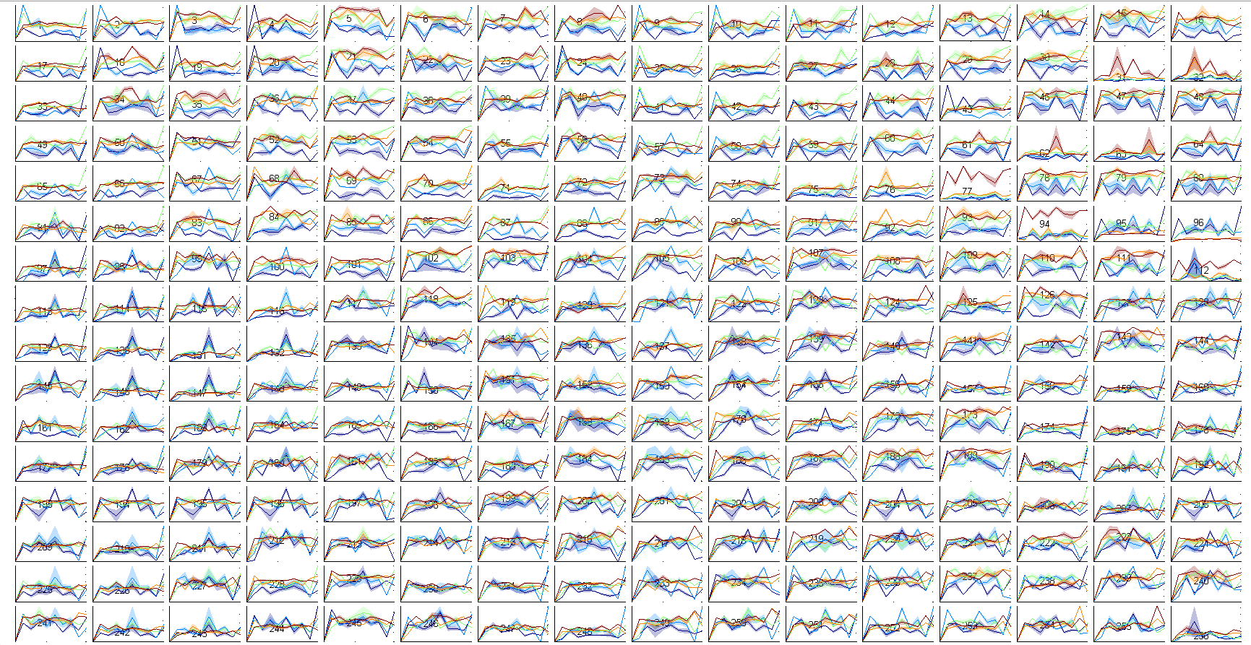
800 to 1200 max

Slide 66
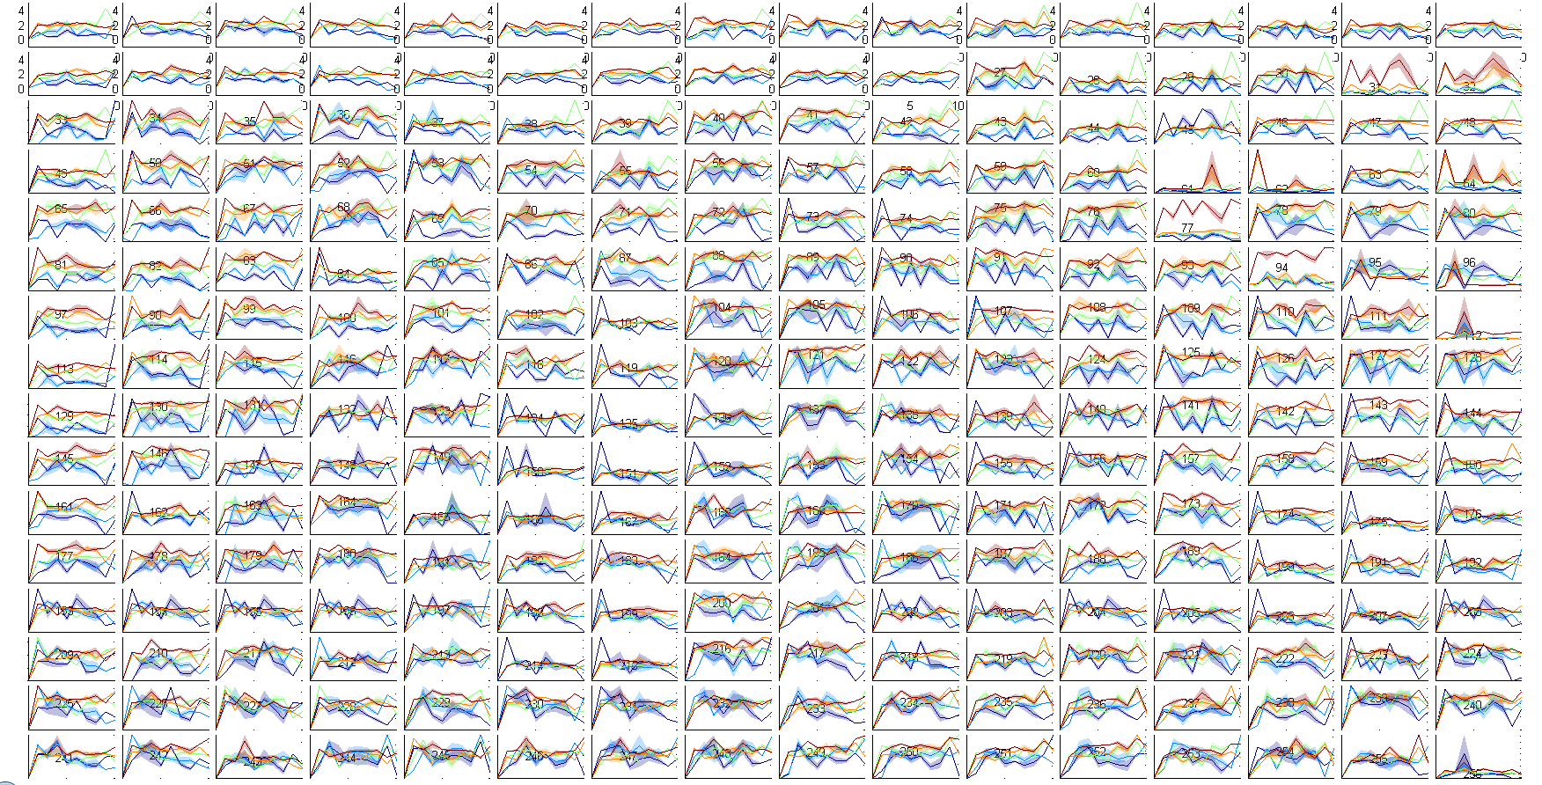
1200 to 1550 max

Slide 67
Mean WE to 2 sec post

Slide 68
Max WE to 2 sec post

Slide 69
Mean 1000-1500 samp

Slide 70
Max 1000-1500 samp

Slide 71
Min 1000-1500 samp

Slide 72
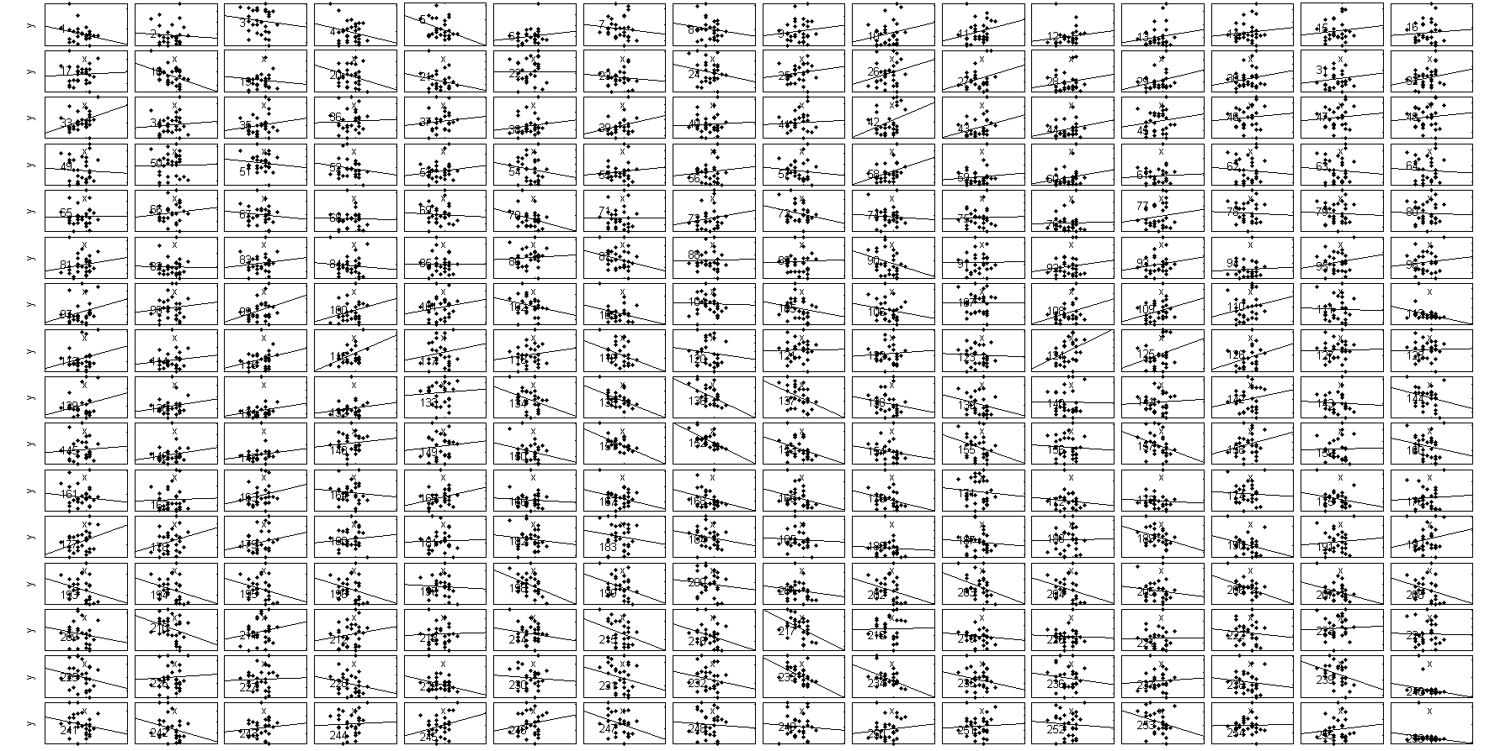
theta
Notes:
Aligned at WE (-1 s to 0). Max zscore

Slide 73
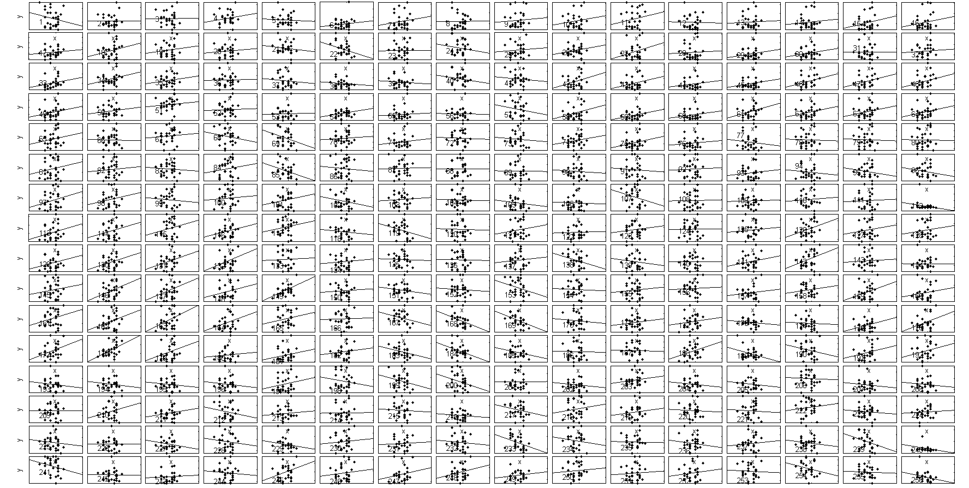
alpha

Slide 74
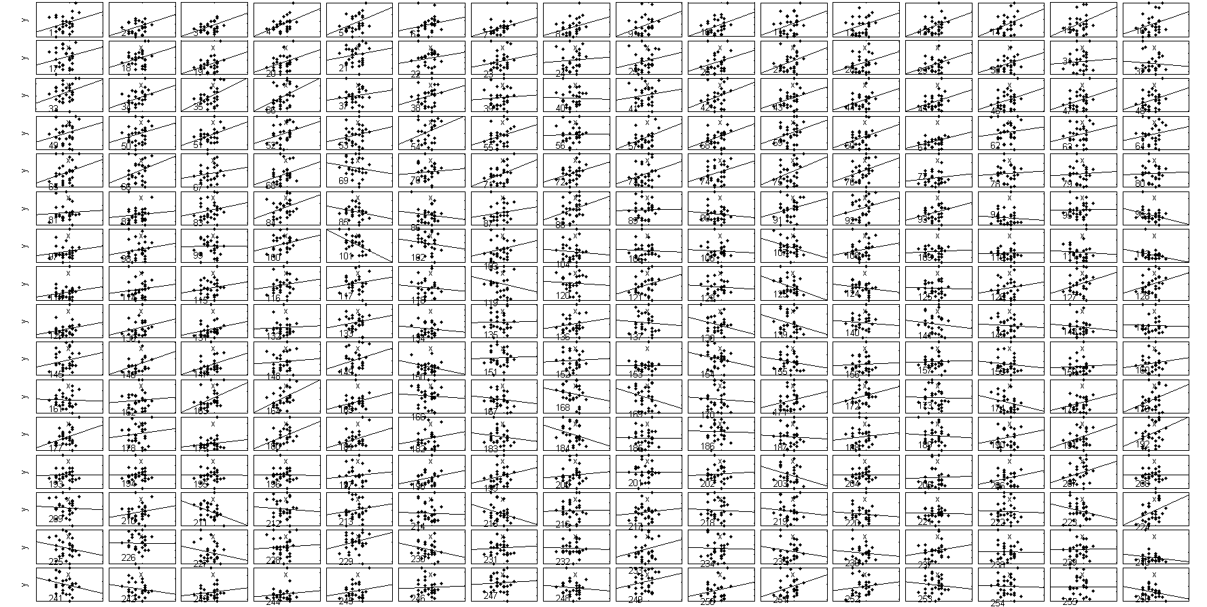
beta

Slide 75
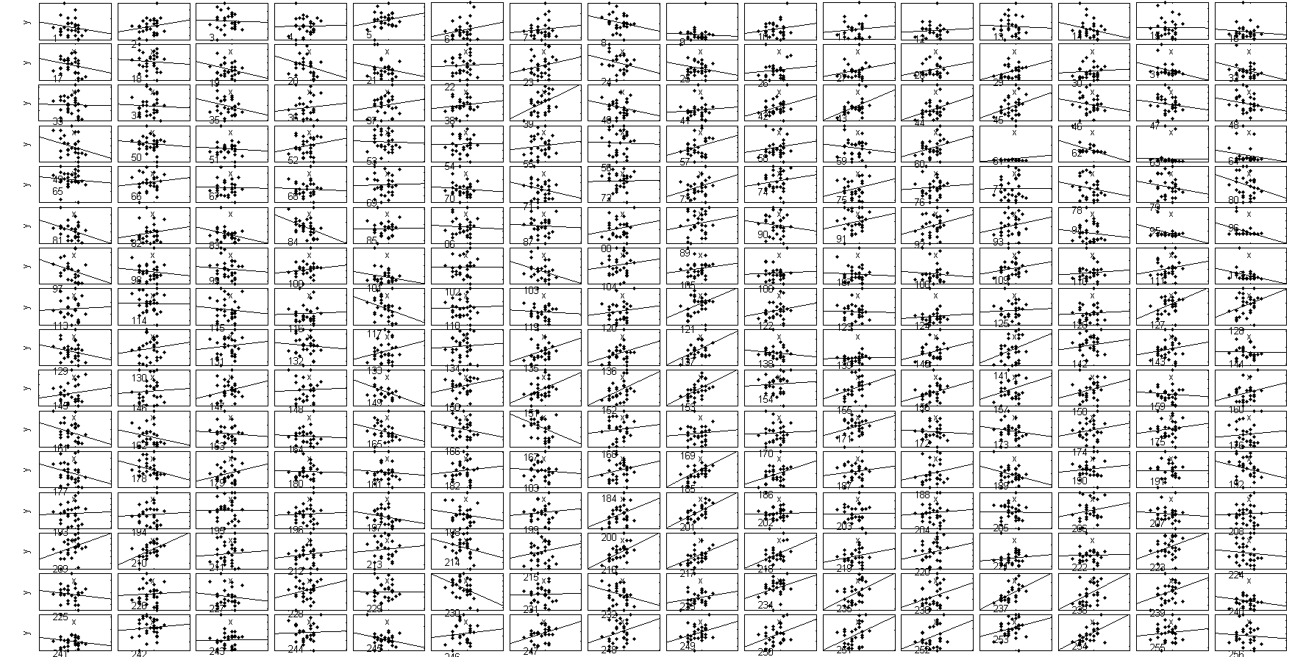
gamma

Slide 76
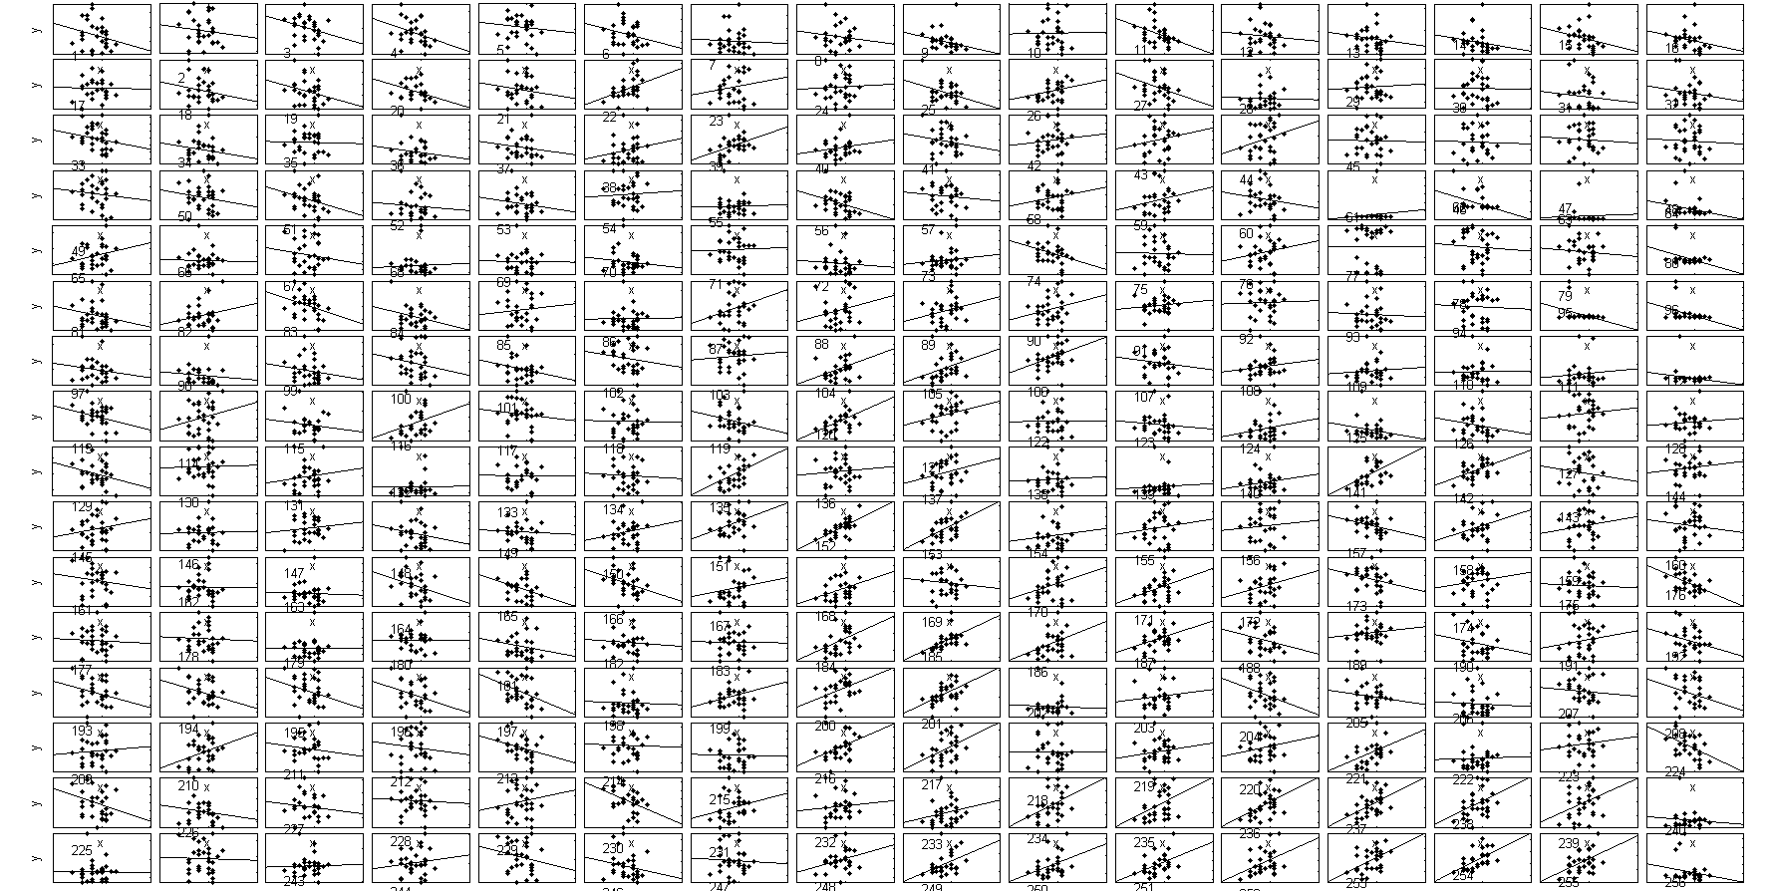
hg

Slide 78
Reconstruction

Slide 79
Corr of Reconstruction at various lags per trial
Max at 100 ms
Notes:
Event= Word presentation
Channels= all
Plot Correlation between reconstruction and sound, and compare to Correlation distrbution between reconstruction and other sounds
EC24

Slide 80
Correlation of Prediction
Trials 1-27

Slide 81
Percentiles of R(match) per trial
Mean= 0.6892+- 0.22
Notes:
At 100 ms lag

Slide 82
Corr at Rep Onset across lags

Slide 83
Percentiles of R(match) per trial

Slide 84
Phase locking

Slide 85
Word onset (plv channel to mean all)

Slide 86
Word end

Slide 89
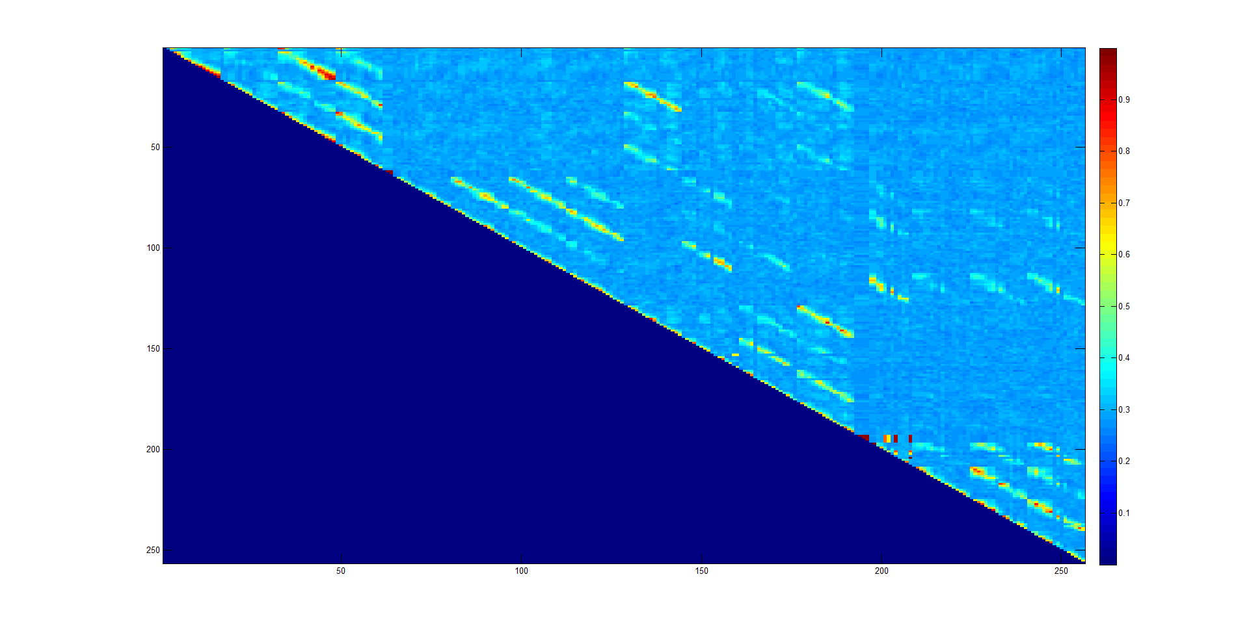
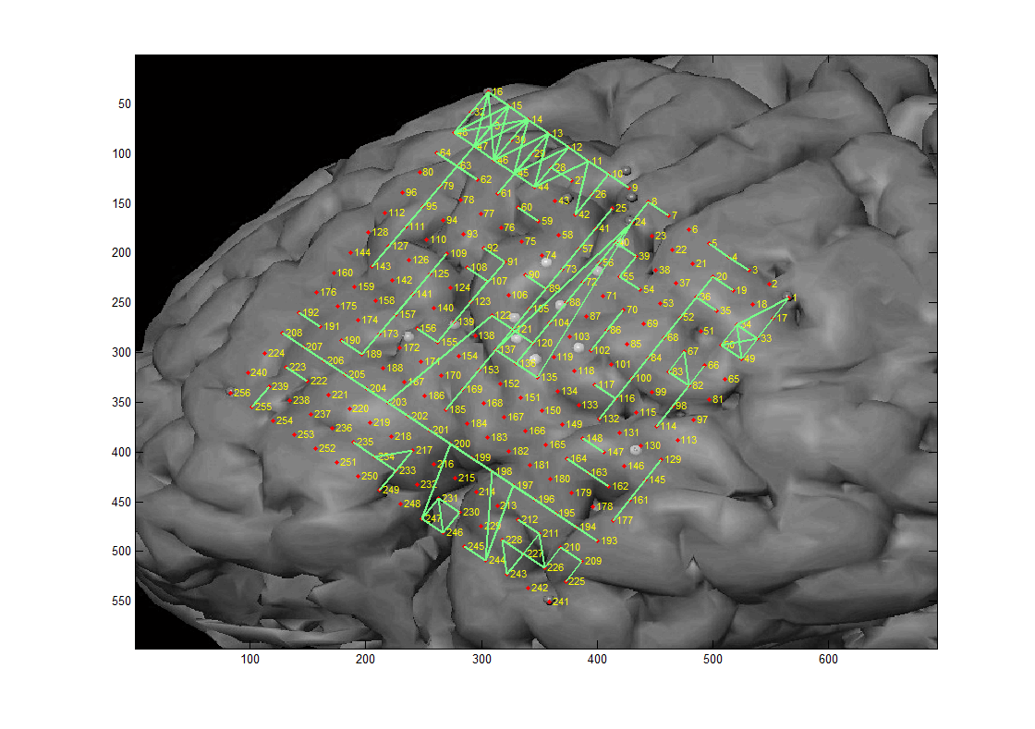
All Channels PLV during baseline
Notes:
Freqband=19

Slide 90
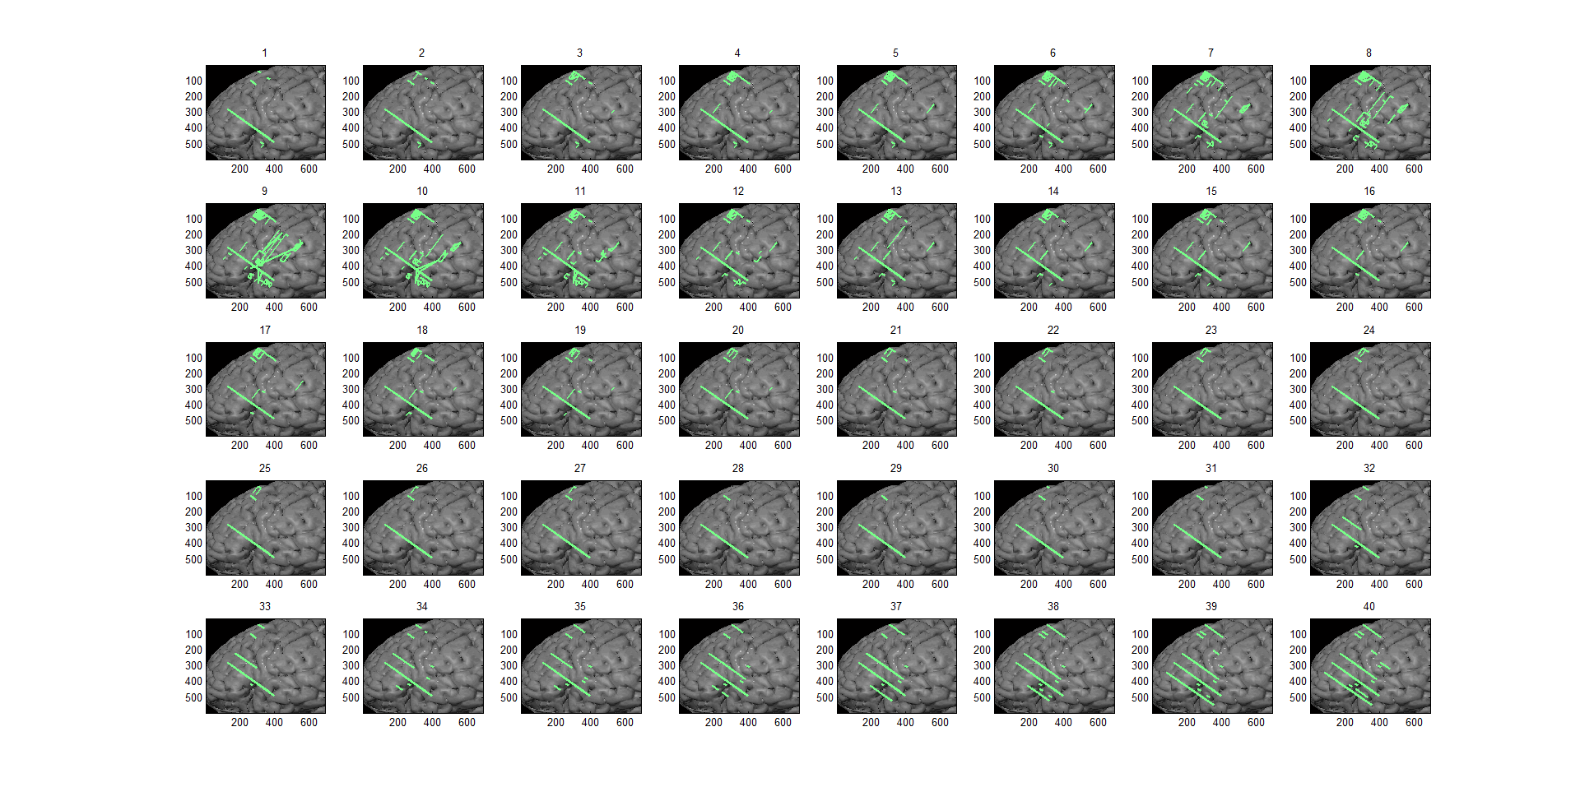
PLV baseline all frequency bands
Notes:
PLV>.85

Slide 91
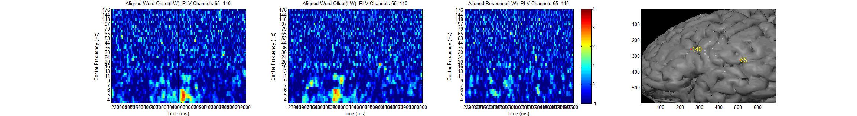
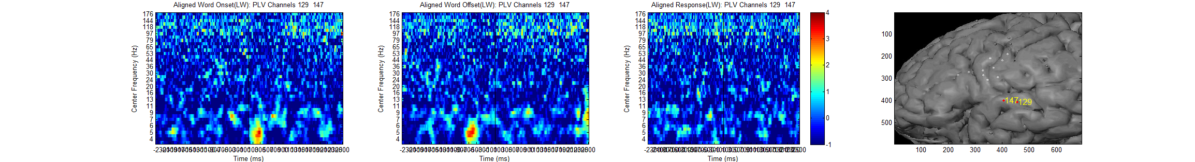
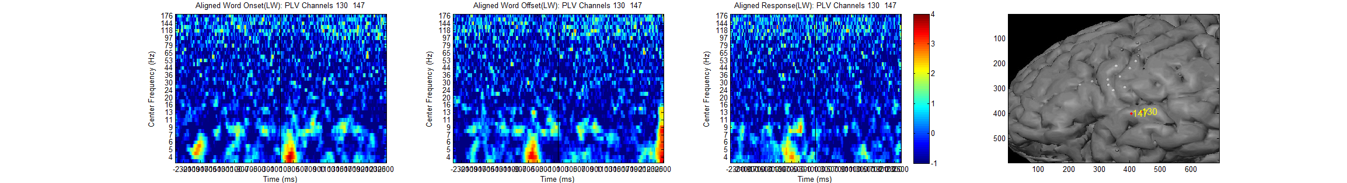
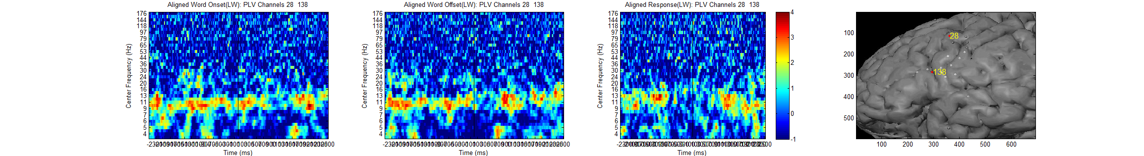
Notes:
chan pair 65 140e=6

Slide 92
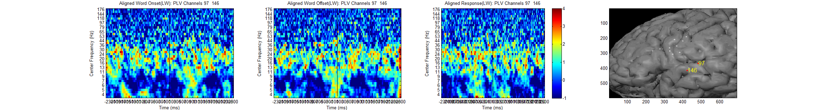
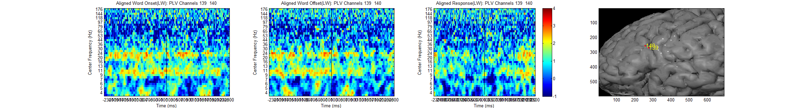
Notes:
chan pair 97 146e=6

Slide 93
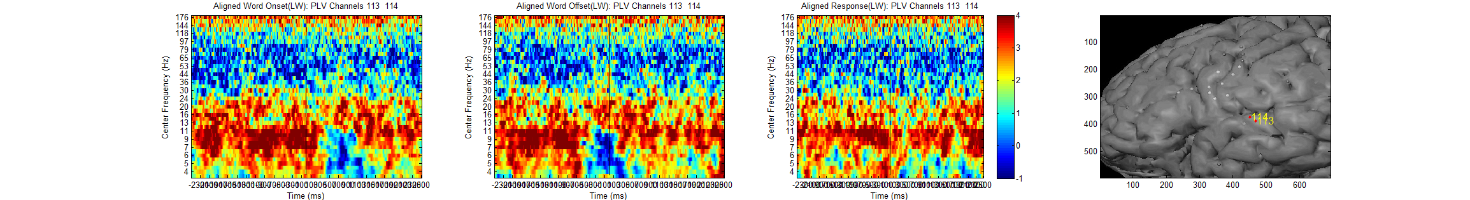
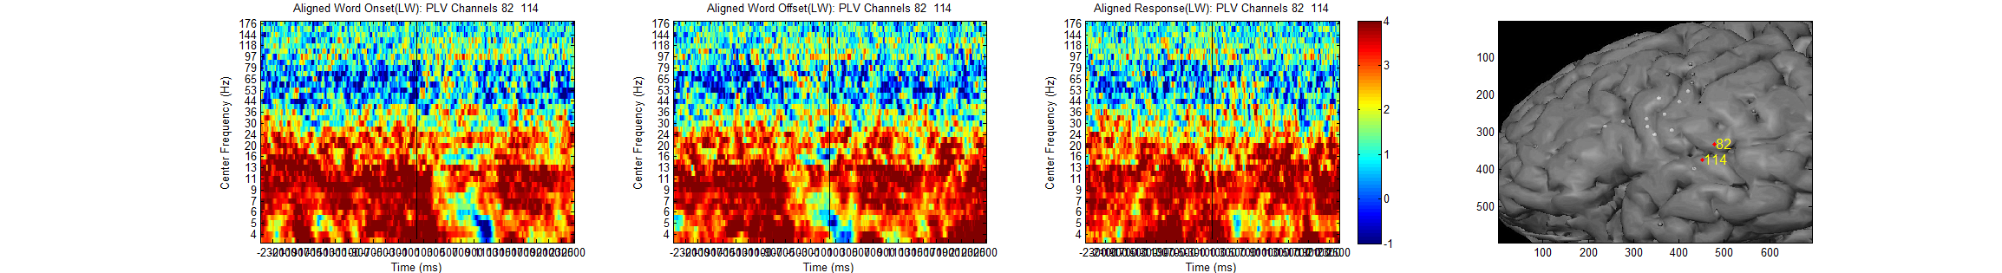
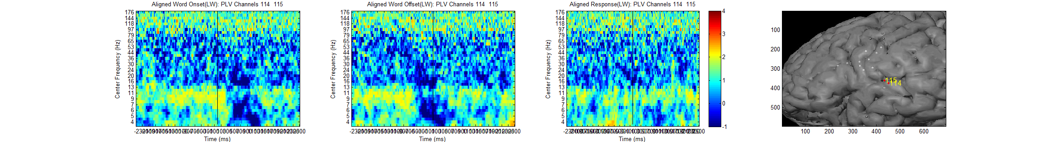
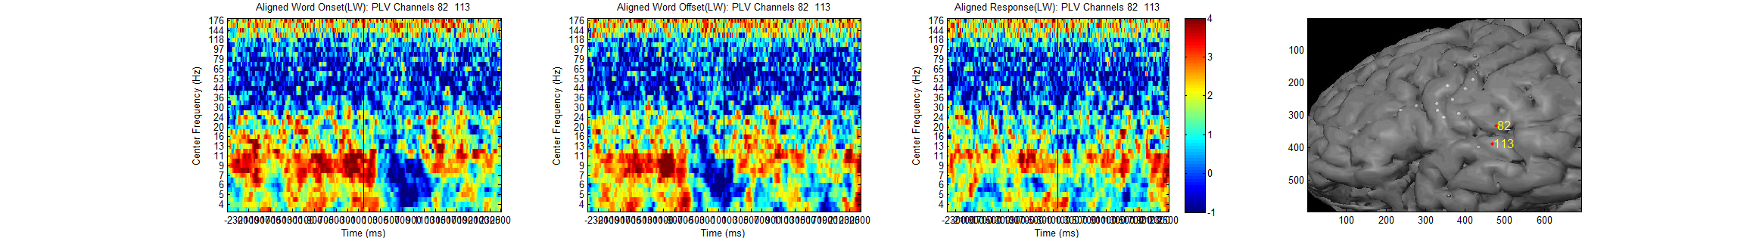
Notes:
chan pair 113 114e=6

Slide 94
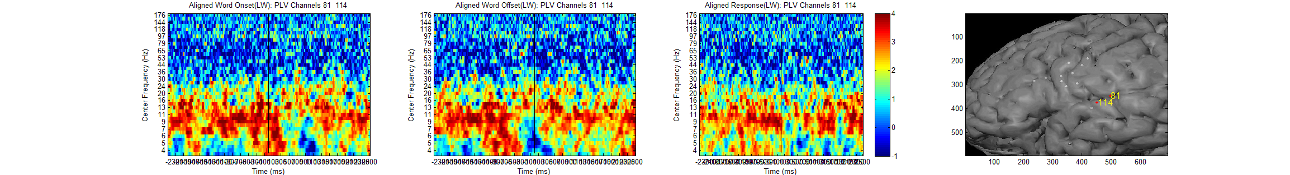
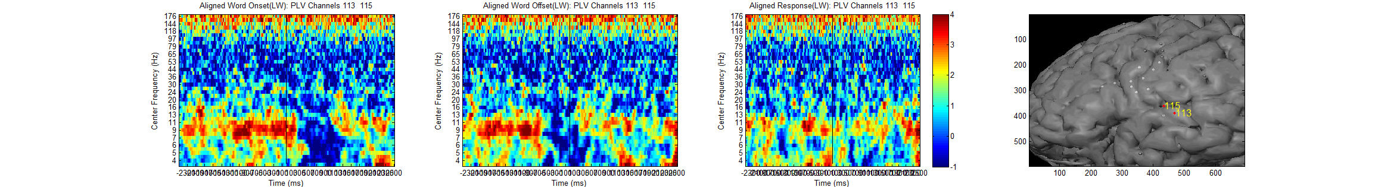
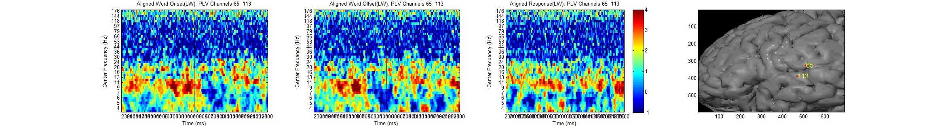
Notes:
chan pair 81 114e=6

Slide 95
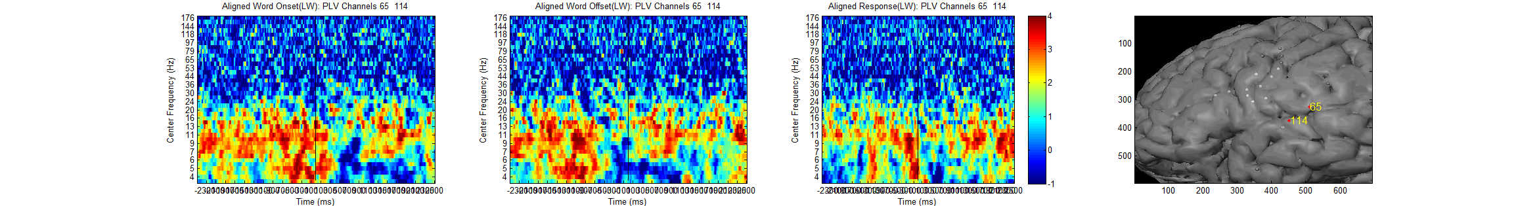

Notes:
chan pair 65 114e=6

Slide 96
Notes:
chan pair 97 146e=6

Slide 97

Notes:
chan pair 11 43e=6 7 8

Slide 98


Slide 99
SVM

Slide 100
All Freq

Slide 101

Correlation between frequency bands per channel
101
Notes:
EC18

Slide 102




HG and Theta Amplitude Correlation in STG
102

Slide 103




High Alpha Amplitude (Central Sulcus)
103

Slide 104








Superior mid-STG (graphs organized poster-> anterior)
Notes:
Not much HG response, except electrode 99
There seems to be some sustained lower frequency activity, which might be activation due to previous slide sound or suppression during word presentation
Not sure about electrode 181 and why there is sustained activity. That might be artifact.
Expectation of word presentation alpha, beta increase

Slide 105








STG inferior poster-> anterior
Notes:
Moving anteriorly, we see strong HG activation at onset of word presentation (as well as at onset of slide sound)
Also observe strong (and sharp) theta activation during sound onset. This might be due to the sharp peaked response of the signal in general, not actual coupling with the theta band

Slide 106


Anterior STG superior → inferior

Slide 107


Mid STG superior → inferior
Notes:
148 and 149 were bad channels

Slide 108


Mid STG superior → inferior
Notes:
The three electrodes exhibit similar response pattern, though electrode 99 is the strongest.
Strong activation of HG band, and suppression lower frequencies with slight delay.
Electrode 99 might be correlated with theta, but that is unclear

Slide 109

























STG spectrograms arranged along Sylvian Fissure (blue line)

Slide 110








Posterior Superior Frontal (upper central sulcus)
Notes:
Electrode 44 and 45, HG responds to word presentation with only short latency
Beta band locked to target presentation offset
These are the same electrodes active during articulation as seen by prior activation (from previous stimulus)
Electrode 28 and 29 active during previous articulation but lower frequency activation sustained throughout slide sound… Odd, need to look into

Slide 111




Frontal
Notes:
Channel 138 sustained activation… also odd
Frontal electrodes (broca’s?) show HG activation negatively correlated with lower frequencies. Longer latency after presentation onset than most other electrodes; probably reaching this region later in activation stream

Slide 112

Electrodes active during delay
Mid-Stg
Somatosensory electrodes at top of central sulcus

Slide 113



Beta band activity following target presentation offset
Motor electrodes show 2 distinct bands in beta frequencies
STG electrode show activation of beta and alpha bands at beginning of delay
Need to compare this to patient with passive test (is this working memory or responsive to any sound offset?)
Notes:
Motor electrodes show 2 distinct bands in beta frequencies
STG electrode show activation of beta and alpha bands at beginning of delay
Need to compare this to patient with passive test

